Slide 1

DATA STRUCTURES AND ITS APPLICATIONS
UE22CS252A (4-0-2-5-5)
Priya Badarinath
Department of Computer Science Engineering

Slide 2
DATA STRUCTURES AND ITS APPLICATIONS
Course Introduction
Priya Badarinath
Department of Computer Science Engineering

Slide 3
DATA STRUCTURE AND ITS APPLICATIONS
What is Data?
Data – Collection of raw facts.
Data structure – is a representation of logical relationship existing between individual elements.
Data structure – Specialized format for organizing and storing the data in memory that considers not only the elements stored but also their relationship to each other.
DS affects the design of both structural and functional aspects of a program.
Program = Algorithm + DS.

Slide 4
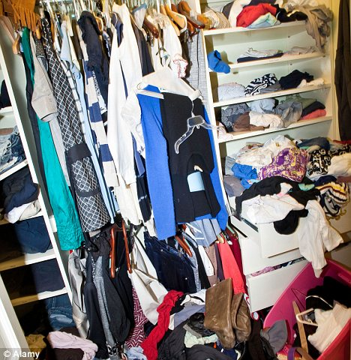
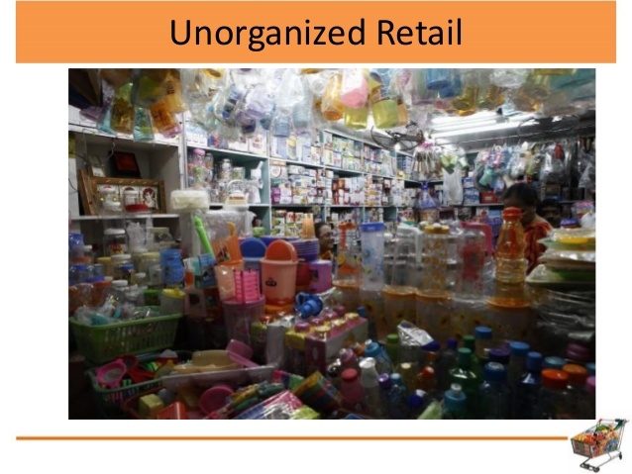
DATA STRUCTURE AND ITS APPLICATIONS
Why Data Structure
I don’t have anything to wear
I cannot find what my customer asks for

Slide 5
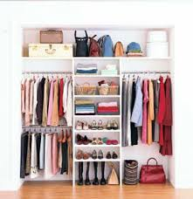
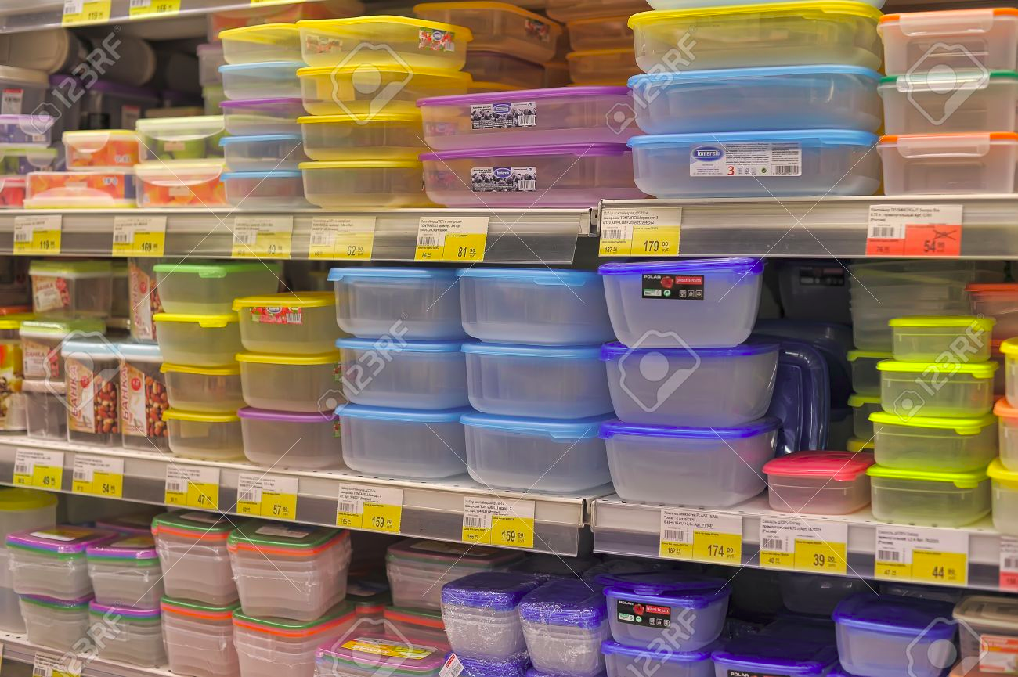
DATA STRUCTURE AND ITS APPLICATIONS
And Now!:-)

Slide 6
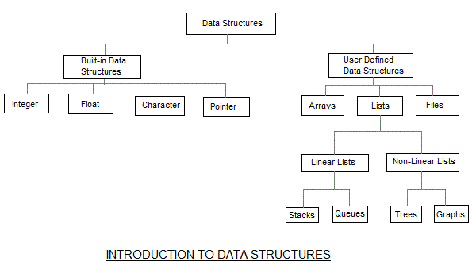
DATA STRUCTURE AND ITS APPLICATIONS
Classification of Data Structures

Slide 7
DATA STRUCTURE AND ITS APPLICATIONS
Primitive Data types and Non Primitive Data types
Data Structures that are directly operated upon machine instructions – Primitive Data Structures.
All data types are Primitive Data Structures.
Data structures that are derived from primitive data types – Non primitive Data Structures
Grouping of homogeneous or heterogeneous data element are Non Primitive Data Structures.

Slide 8

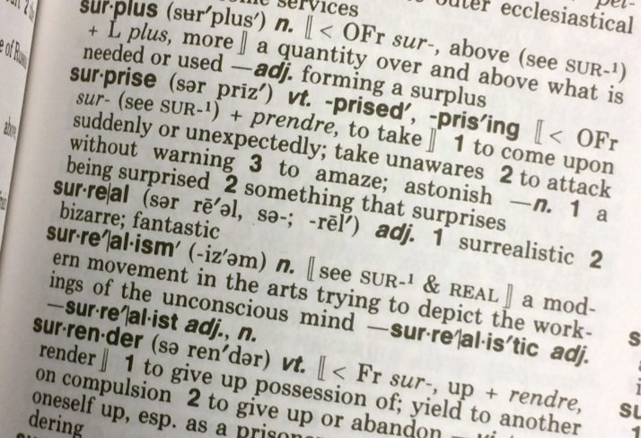
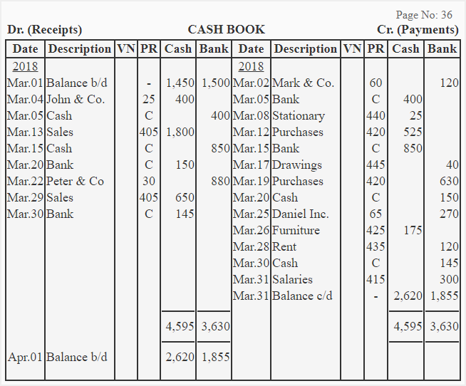
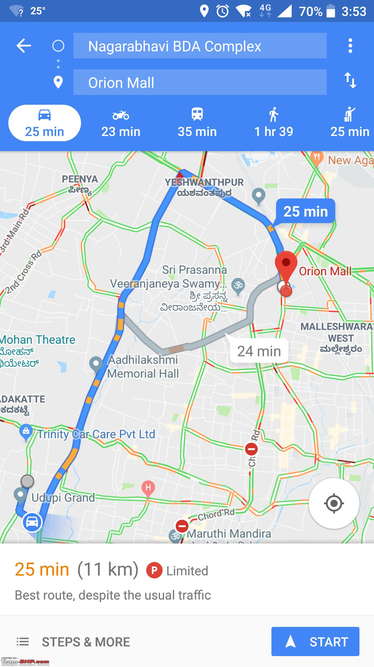
DATA STRUCTURE AND ITS APPLICATIONS
Applications of Data Structure
.

Slide 9
DATA STRUCTURES AND ITS APPLICATIONS
Topics : Unit Wise
Others:
Unit 1 : Overview of C, Linked List & Stacks
Unit 2: Queues & Introduction to Trees
Unit 3: Application of Trees , Introduction to Graph
Unit 4: Application of Graphs, Suffix Tree and Hashing
Course Information
Syllabus
Assignment
Practise Problems

Slide 10
DATA STRUCTURES AND ITS APPLICATIONS
Evaluation Policy : ISA and Laboratory
 | Conducted | Scaled to
ISA -1 (Unit 1 & Unit 2) | 40 | 20
ISA -2 (Unit 3 & Unit 4) | 40 | 20
Experiential Learning / HALP – Mini Project | 20 | 10
Lab (Total 12 Labs) | 10 | 20
ESA | 100 | 50
Total |  | 120(scaled to 100)

Slide 11
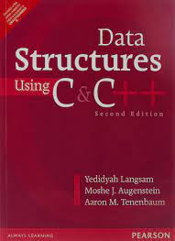
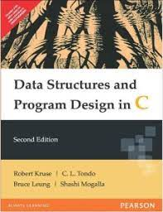
DATA STRUCTURES AND ITS APPLICATIONS
TEXT BOOK / REFERENCE BOOKS
Text Book:
1.“Data Structures using C / C++” , Langsum Yedidyah, Moshe J Augenstein, Aaron M Tenenbaum Pearson Education Inc, 2nd edition, 2015.
Reference Book:
1: “Data Structures and Program Design in C”, Robert Kruse, Bruce Leung, C.L Tondo, Shashi Mogalla, Pearson, 2nd Edition, 2019.

Slide 12
Arrays in C
All elements of same type – homogenous
array size in declaration
int array[10];
int b;
array[0] = 3;
array[9] = 4;
array[10] = 5;
First element (index 0)
Last element (index size - 1)
No bounds checking!

Slide 13
Array Representation
Homogeneous → Each element same size – s bytes
An array of m data values is a sequence of m×s bytes
Indexing: 0th value at byte s×0, 1st value at byte s×1, …
0x1008
a[2]
0x1004
a[1]
int a[3];
0x1000
a[0]

Slide 14
Array Representation
char c1;
int a[3];
char c2;
int i;
0x1014
i
0x1010
c2
0x100C
a[2]
Could be optimized by making these adjacent, and reducing padding (by default, not)
0x1008
a[1]
0x1004
a[0]
0x1000
c1
Array aligned by
size of elements

Slide 15
Array Sizes
What is
sizeof(array[3])?
sizeof(array)?
int array[10];
returns the size of
an object in bytes
4
40

Slide 16
Multi-Dimensional Arrays
4116
matrix[1][2]
4112
matrix[1][1]
int matrix[2][3];
matrix[1][0] = 17;
4108
matrix[1][0]
4104
matrix[0][2]
4100
matrix[0][1]
4096
matrix[0][0]
“Row Major”
Organization

Slide 17
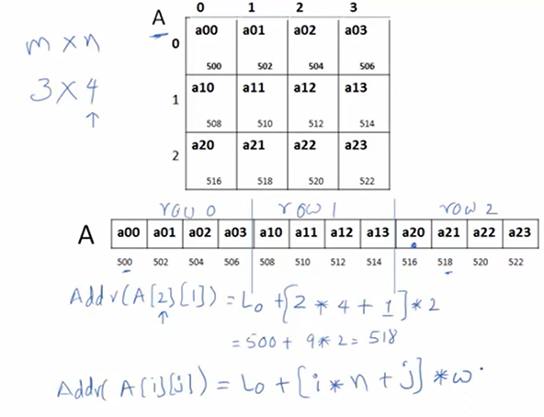
Row major Ordering-Index starting from zero

Slide 18
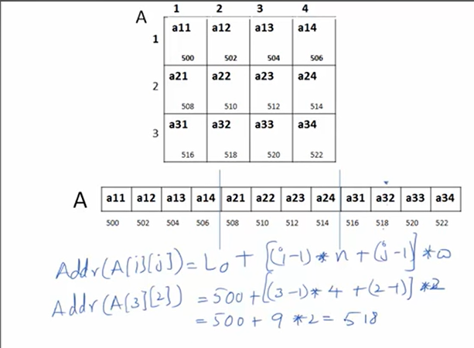
Row major Ordering-Index starting from one

Slide 19
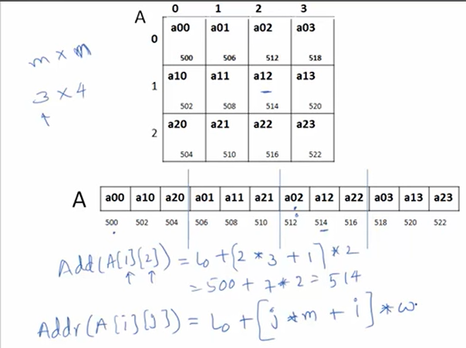
column major Ordering-Index starting from zero

Slide 20
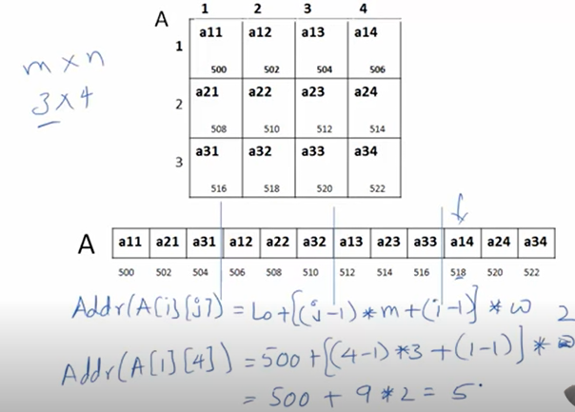
column major Ordering-Index starting from one

Slide 21
Program
Write a program to display both address and value of element using array.
A[4]={1,2,3,4}
Try to display address using %p and %d.
Array.c

Slide 22
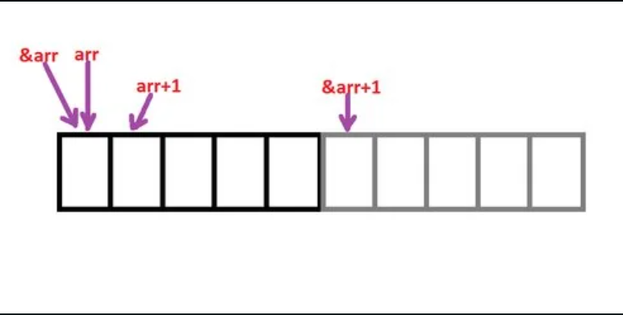
Array vs &Array

Slide 23
Program
2. Write a program to display
Array base address using array and &array
What happens when array+1 is given.
What happens when &array+1 is given.
Array1.c

Slide 24
Pointers

Slide 25
Pointer Declarations
Pointer variables must be declared before we use them.
General form:
data_type *pointer_name;
Three things are specified in the above declaration:
The asterisk (*) tells that the variable pointer_name is a pointer variable.
pointer_name needs a memory location.
pointer_name points to a variable of type data_type.

Slide 26
Pointers-Pointers (pointer variables) are special variables that are used to store addresses rather than values.
Address in C
If you have a variable var in your program, &var will give you its address in the memory.
We have used address numerous times while using the scanf() function.
scanf("%d", &var);
Here, the value entered by the user is stored in the address of var variable. Let's take a working example.
#include <stdio.h>
int main()
{
int var = 5;
printf("var: %d\n", var);
// Notice the use of & before var
printf("address of var: %p", &var);
return 0;
}
Output
var: 5
address of var: 2686778

Slide 27
Pointer Syntax
int* p;
can also declare pointers in these ways.
int *p1;
int * p2;
Assigning addresses to Pointers
int* pc, c;
c = 5;
pc = &c;
Get Value of Thing Pointed by Pointers
int* pc, c;
c = 5;
pc = &c;
printf("%d", *pc); // Output: 5
Changing Value Pointed by Pointers
int* pc, c;
c = 5;
pc = &c;
c = 1;
printf("%d", c); // Output: 1
printf("%d", *pc); // Ouptut: 1

Slide 28
Common mistakes when working with pointers
int c, *pc;
// pc is address but c is not
pc = c; // Error
// &c is address but *pc is not
*pc = &c; // Error
// both &c and pc are addresses
pc = &c; // Not an error
// both c and *pc are values
*pc = c; // Not an error

Slide 29
They have a number of useful applications.
Enables us to access a variable that is defined outside the function.-ptr1
Can be used to pass information back and forth between a function and its reference point.-ptr2
More efficient in handling data tables.
Reduces the length and complexity of a program.
Sometimes also increases the execution speed.

Slide 30
Contd.
Following usages are illegal:
&235
Pointing at constant.
int arr[20];
:
&arr;
Pointing at array name.
&(a+b)
Pointing at expression.

Slide 31
Program to display the values and memory addresses of different data types-ptr3.c

Slide 32
Example 1
#include <stdio.h>
main()
{
int a, b;
int c = 5;
int *p;
a = 4 * (c + 5) ;
p = &c;
b = 4 * (*p + 5) ;
printf (“a=%d b=%d \n”, a, b) ;
}
Equivalent

Slide 33
Example program-ptr4.c
Explain the operations with pointers in the given C code and trace the output produced by the printf statements .

Slide 34
Pointer Expressions
Like other variables, pointer variables can be used in expressions.
If p1 and p2 are two pointers, the following statements are valid:
sum = *p1 + *p2 ;
prod = *p1 * *p2 ;
prod = (*p1) * (*p2) ;
*p1 = *p1 + 2;
x = *p1 / *p2 + 5 ;

Slide 35
Contd.
What are allowed in C?
Add an integer to a pointer- ptr5.c
Subtract an integer from a pointer. - ptr6.c
Subtract one pointer from another (related). Ptr7.c
If p1 and p2 are both pointers to the same array, them p2–p1 gives the number of elements between p1 and p2.
What are not allowed?
Add two pointers.
p1 = p1 + p2 ;
Multiply / divide a pointer in an expression.
p1 = p2 / 5 ;
p1 = p1 – p2 * 10 ;

Slide 36
Passing Pointers to a Function
Pointers are often passed to a function as arguments.
Allows data items within the calling program to be accessed by the function, altered, and then returned to the calling program in altered form.
Called call-by-reference (or by address or by location).
Normally, arguments are passed to a function by value.
The data items are copied to the function.
Changes are not reflected in the calling program.

Slide 37
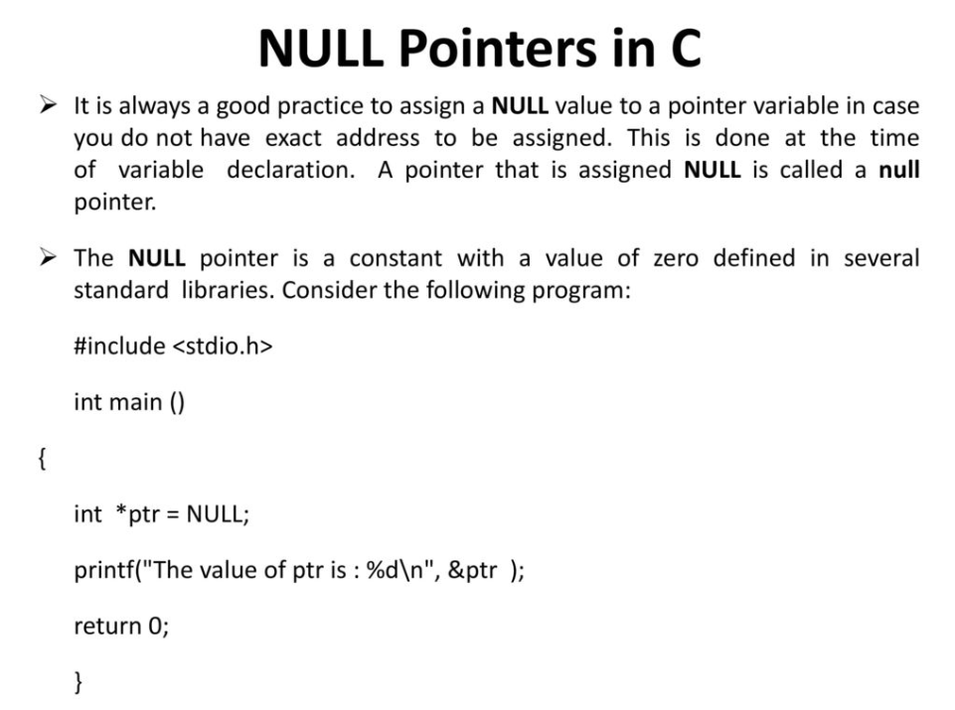

Slide 38
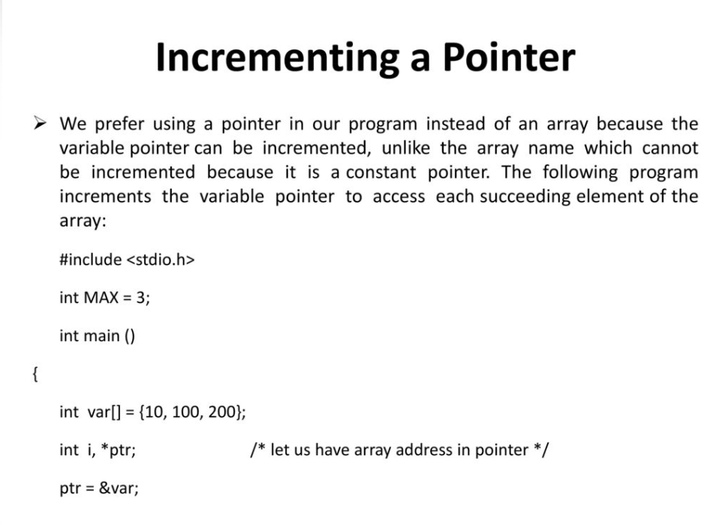

Slide 39
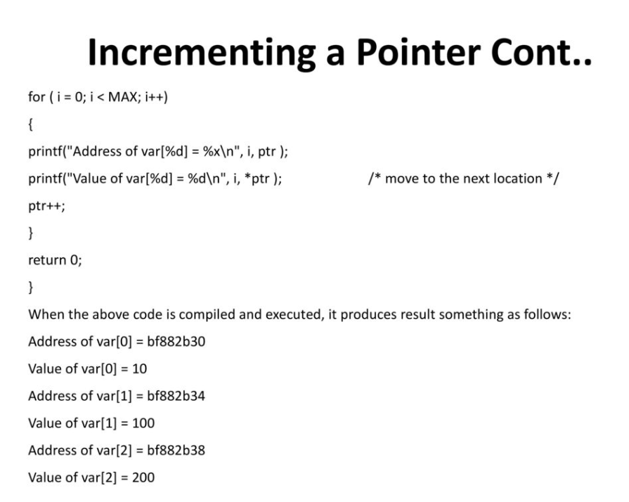

Slide 40
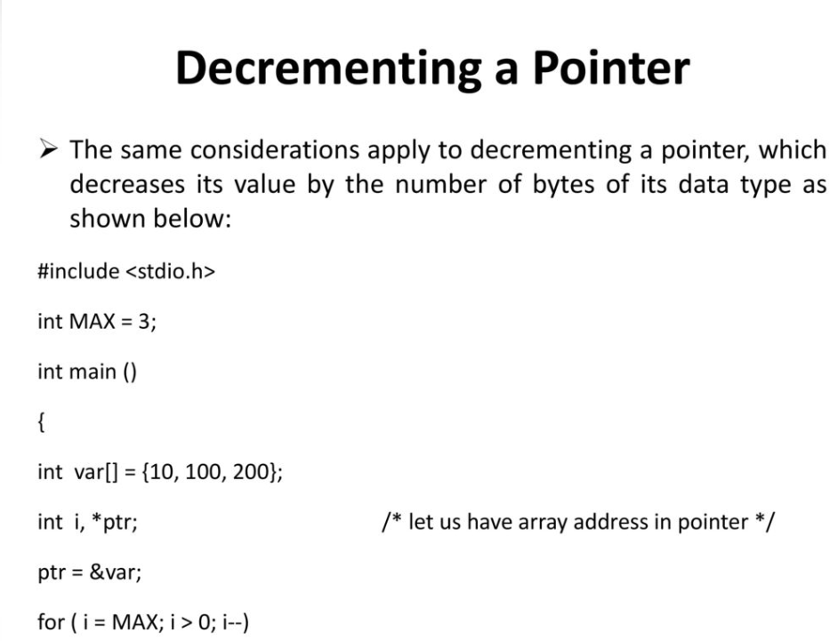

Slide 41
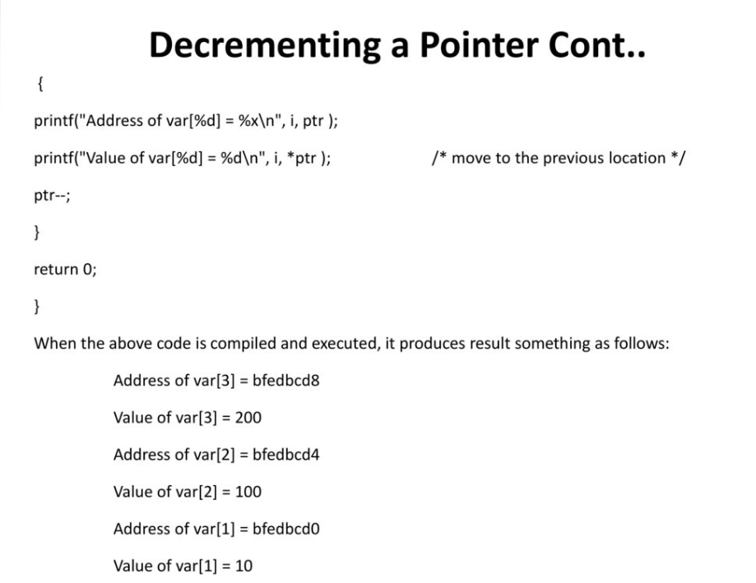

Slide 42
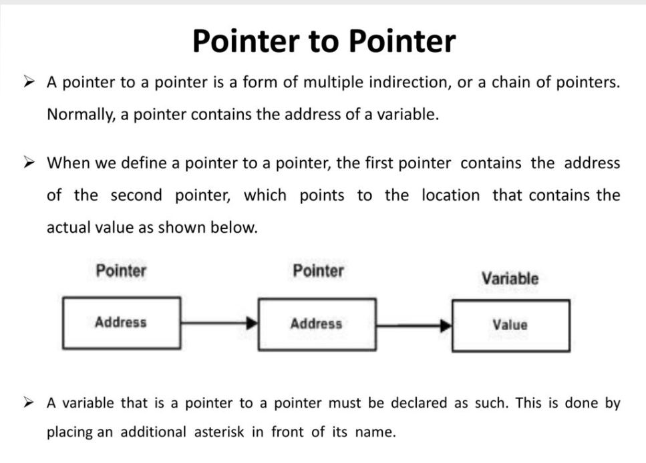

Slide 43
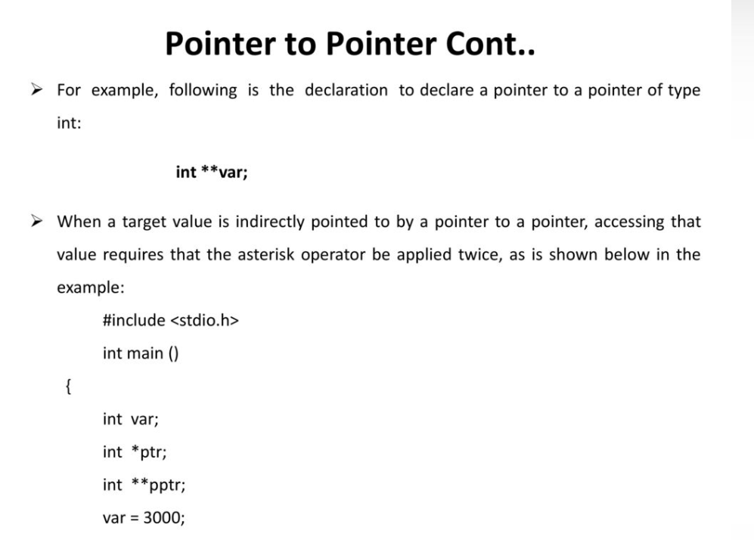

Slide 44
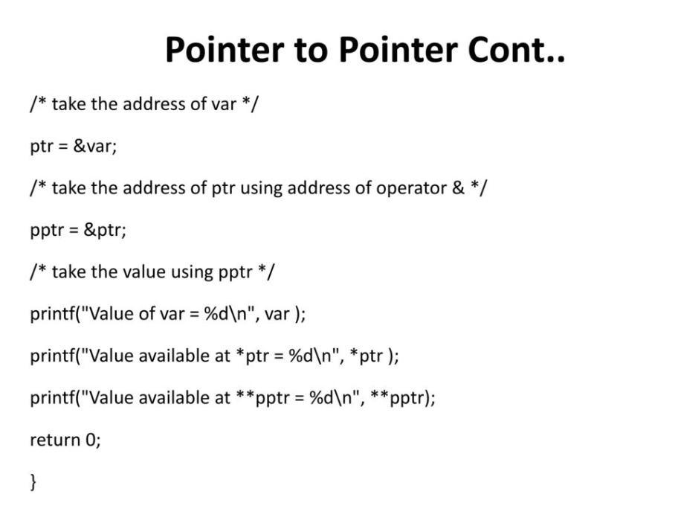

Slide 45
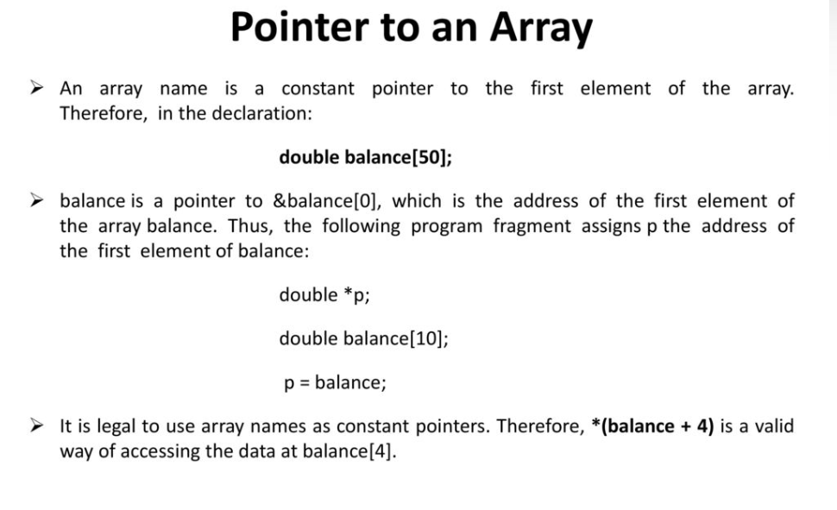

Slide 46
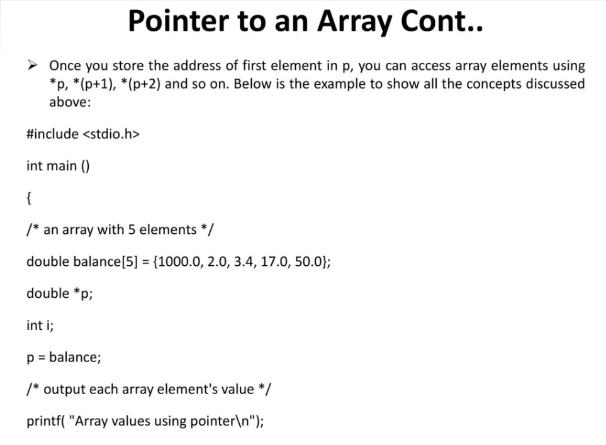

Slide 47
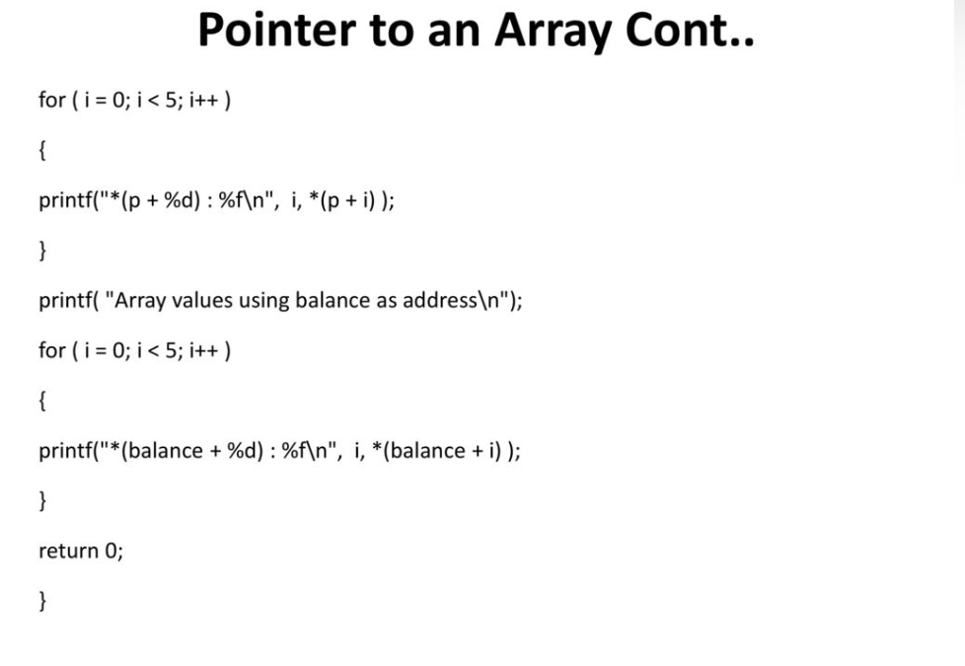

Slide 48
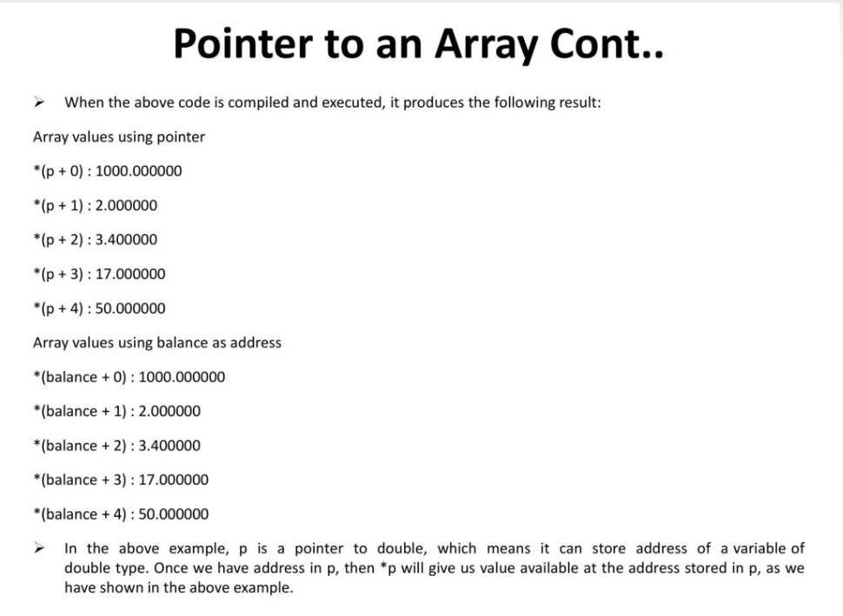

Slide 49
Example: passing arguments by value- ptr8.c

Slide 50
Example: passing arguments by reference – ptr9.c

Slide 51
Why structs in C?
Suppose you want to store information about a person: his/her name, citizenship number, and salary. You can create different variables name, citNo and salary to store this information.
What if you need to store information of more than one person? Now, you need to create different variables for each information per person: name1, citNo1, salary1, name2, citNo2, salary2, etc.
A better approach would be to have a collection of all related information under a single name Person structure and use it for every person.
In C programming, a struct (or structure) is a collection of variables (can be of different types) under a single name.

Slide 52
Syntax of struct
struct structureName {
dataType member1;
dataType member2;
...
};
For example,
struct Person {
char name[50];
int citNo;
float salary;
};

Slide 53
Create struct Variables When a struct type is declared, no storage or memory is allocated. To allocate memory of a given structure type and work with it, we need to create variables.
struct Person {
// code
};
int main() {
struct Person person1, person2, p[20];
return 0;
}
Another way of creating a struct variable is:
struct Person {
// code
} person1, person2, p[20];
In both cases,
person1 and person2 are struct Person variables
p[] is a struct Person array of size 20.

Slide 54
Access Members of a Structure
There are two types of operators used for accessing members of a structure.
. - Member operator
-> - Structure pointer operator
Suppose, you want to access the salary of person2. Here's how you can do it.
person2.salary
Struct1.c

Slide 55
Nested Structures
struct complex {
int imag;
float real;
};
struct number {
struct complex comp;
int integers;
} num1, num2;
Struct2.c

Slide 56
C structs and Pointers
struct name {
member1;
member2;
.
.
};
int main()
{
struct name *ptr, Harry;
}
ptr is a pointer to struct.

Slide 57
Example: Access members using Pointer
Struct3.c

Slide 58
Passing structs to functions
Struct4.c

Slide 59
Passing struct by reference
You can also pass structs by reference (in a similar way like you pass variables of built-in type by reference). We suggest you to read pass by reference tutorial before you proceed.
During pass by reference, the memory addresses of struct variables are passed to the function.
Struct5.c

Slide 60
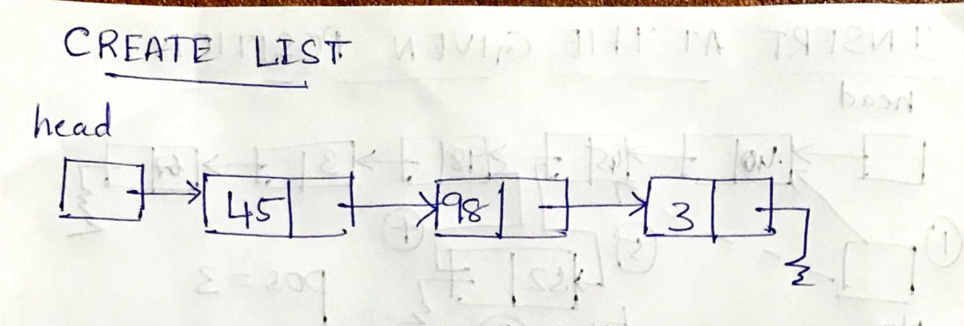

Slide 61
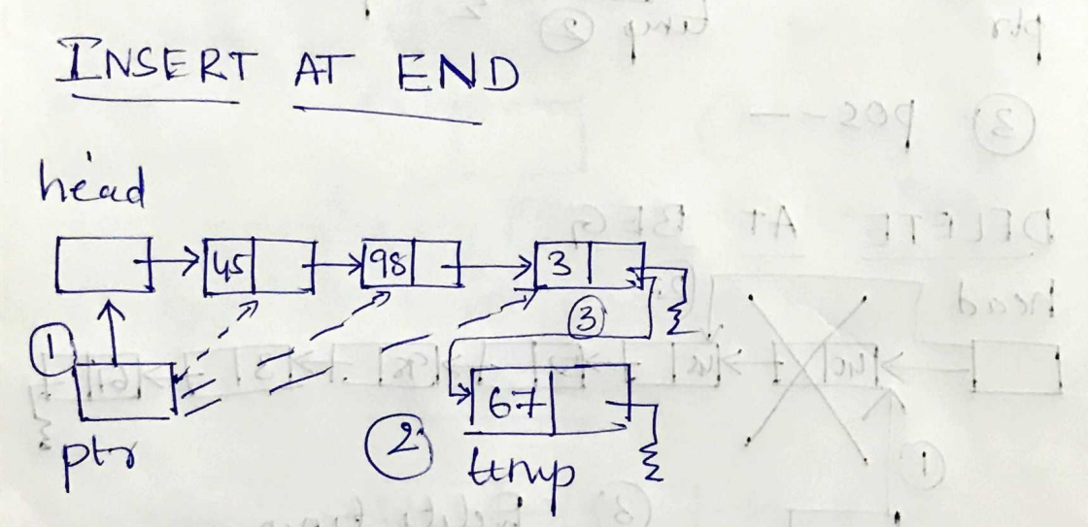

Slide 62
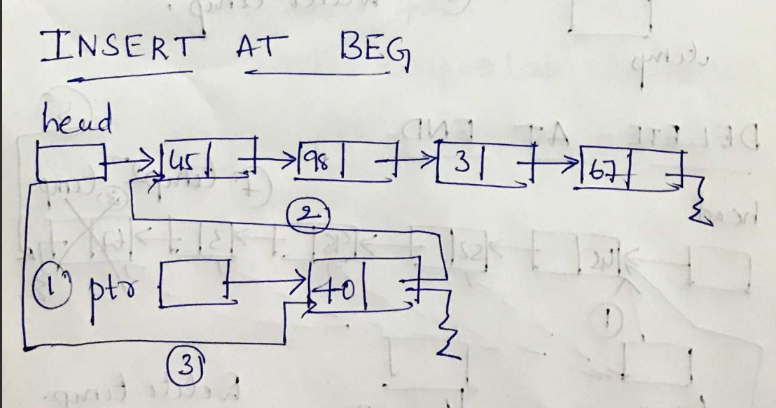

Slide 63
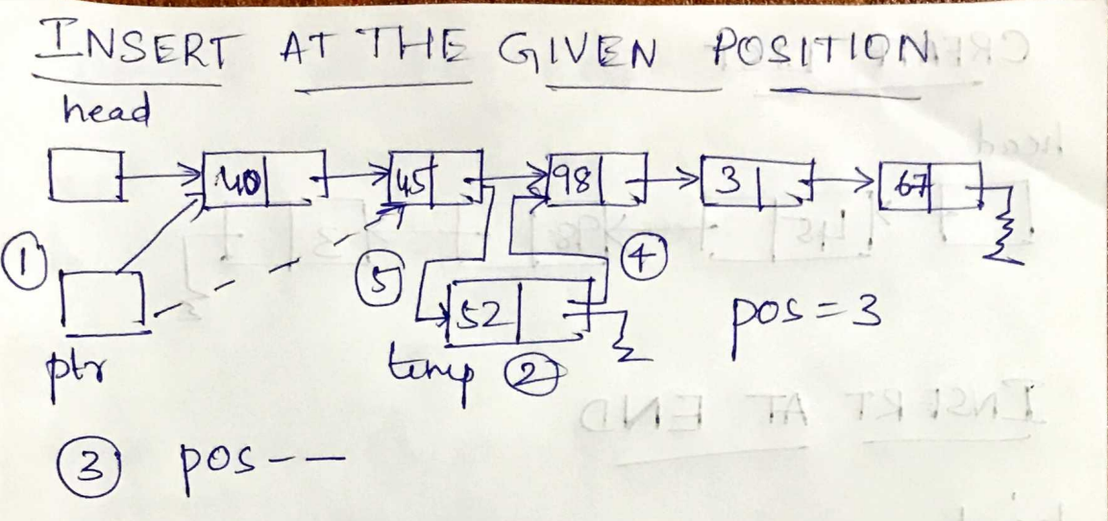

Slide 64
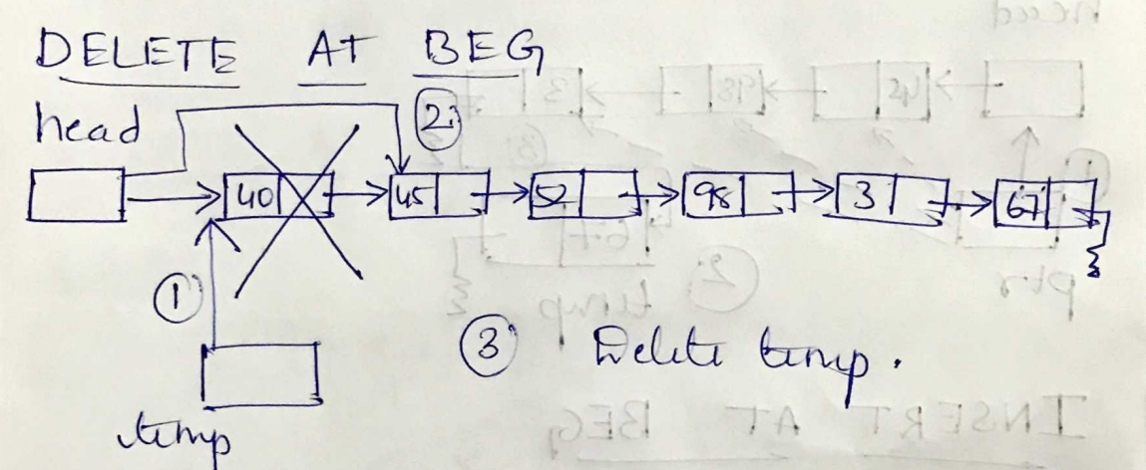

Slide 65
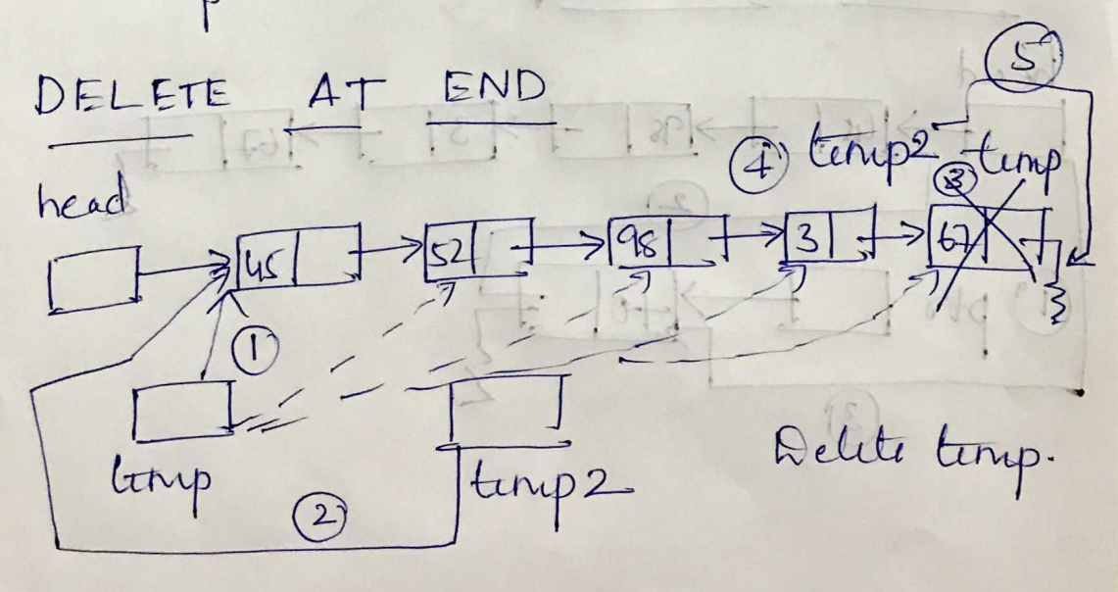

Slide 66
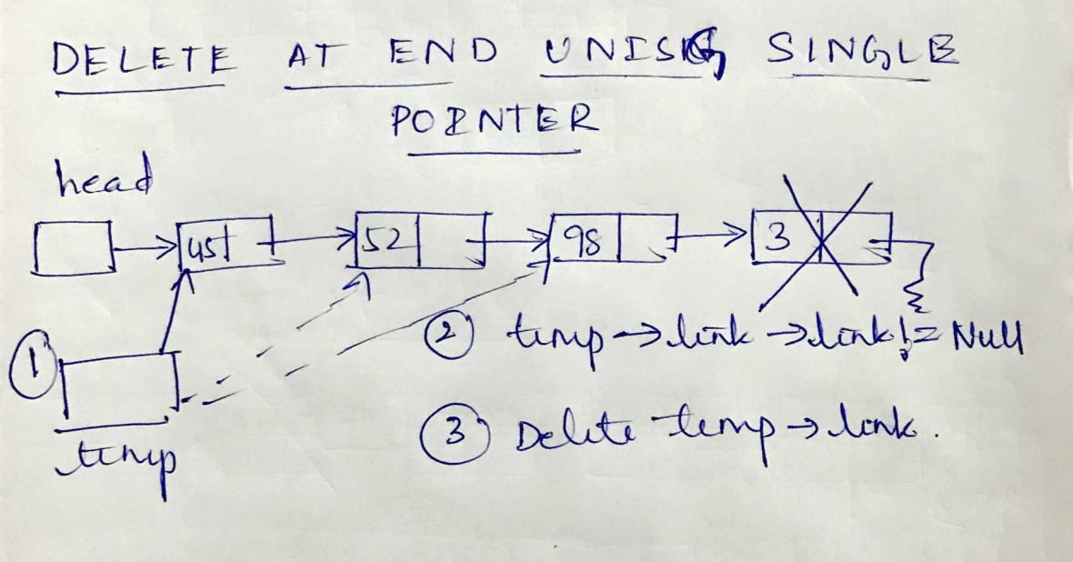

Slide 67
